Slide 1
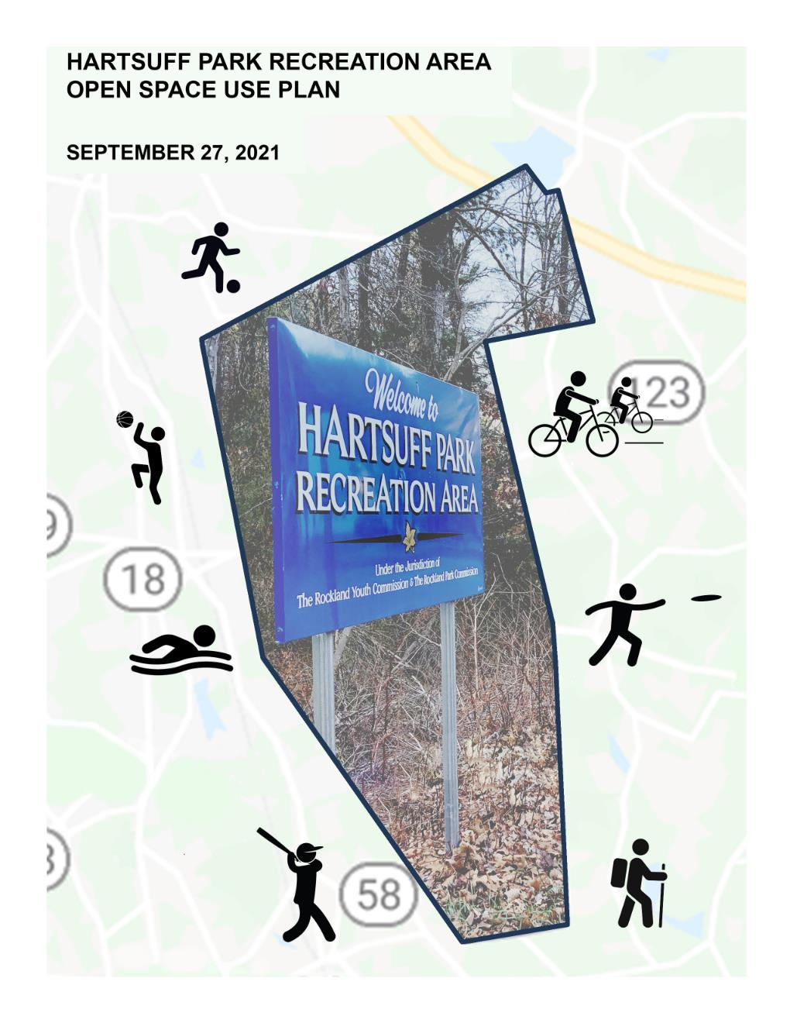

Slide 2
PROJECT TIMELINE
COMMITTEE MEETING WITH LA RECCOMENDATIONS
COMMITTEE PARK PRIORITIES LIST COMPLETE
PROJECT
KICK OFF
3.6.2021
6.2.2021
9.27.2021
12.17.2020
4.25.2021
7.7.2021
PUBLIC SURVEY ENDS
FINAL USE PLAN COMPLETED
PARK USE DOCUMENT COMPLETE

Slide 3
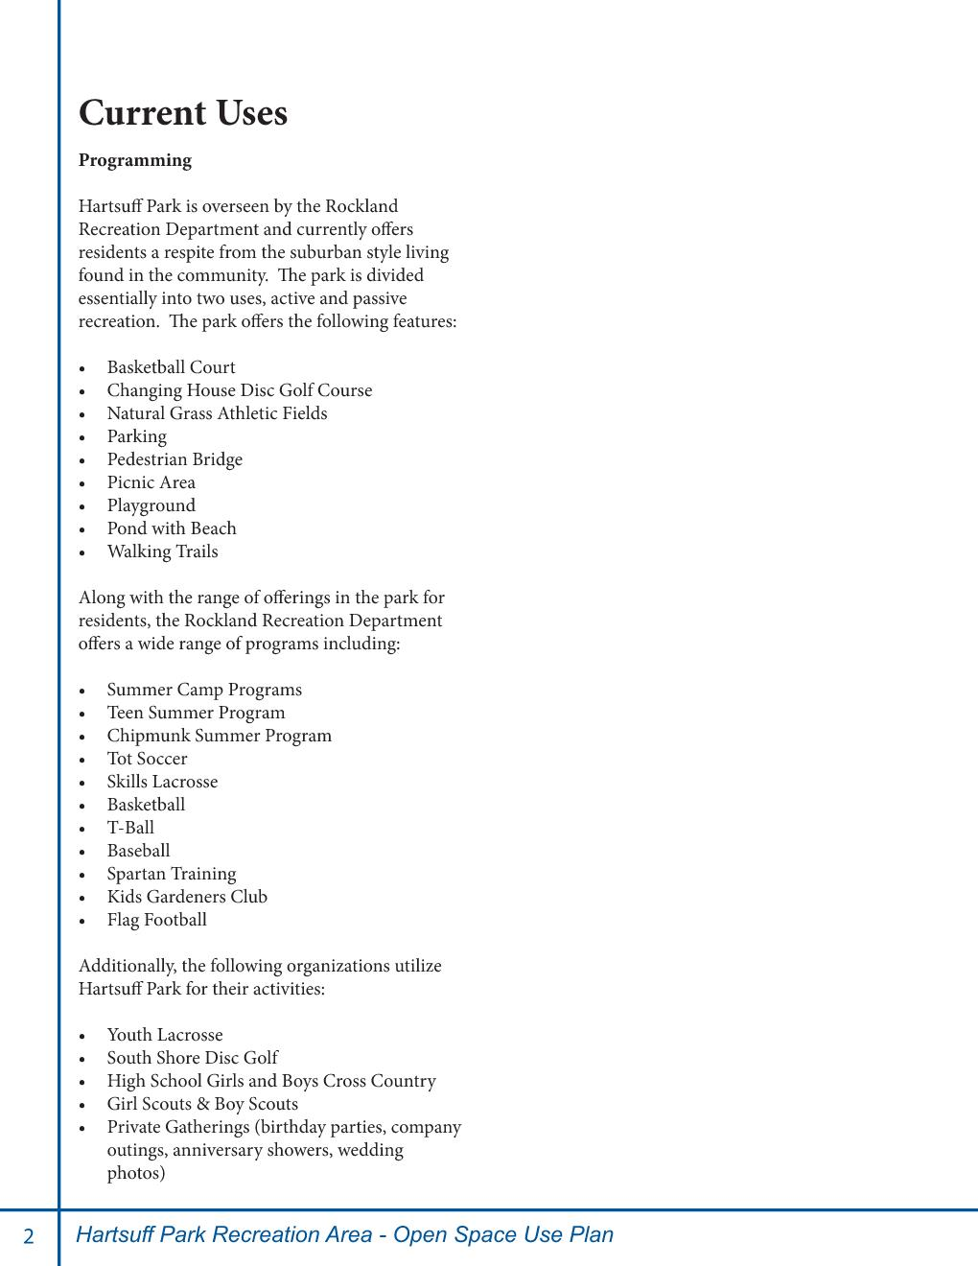

Slide 4
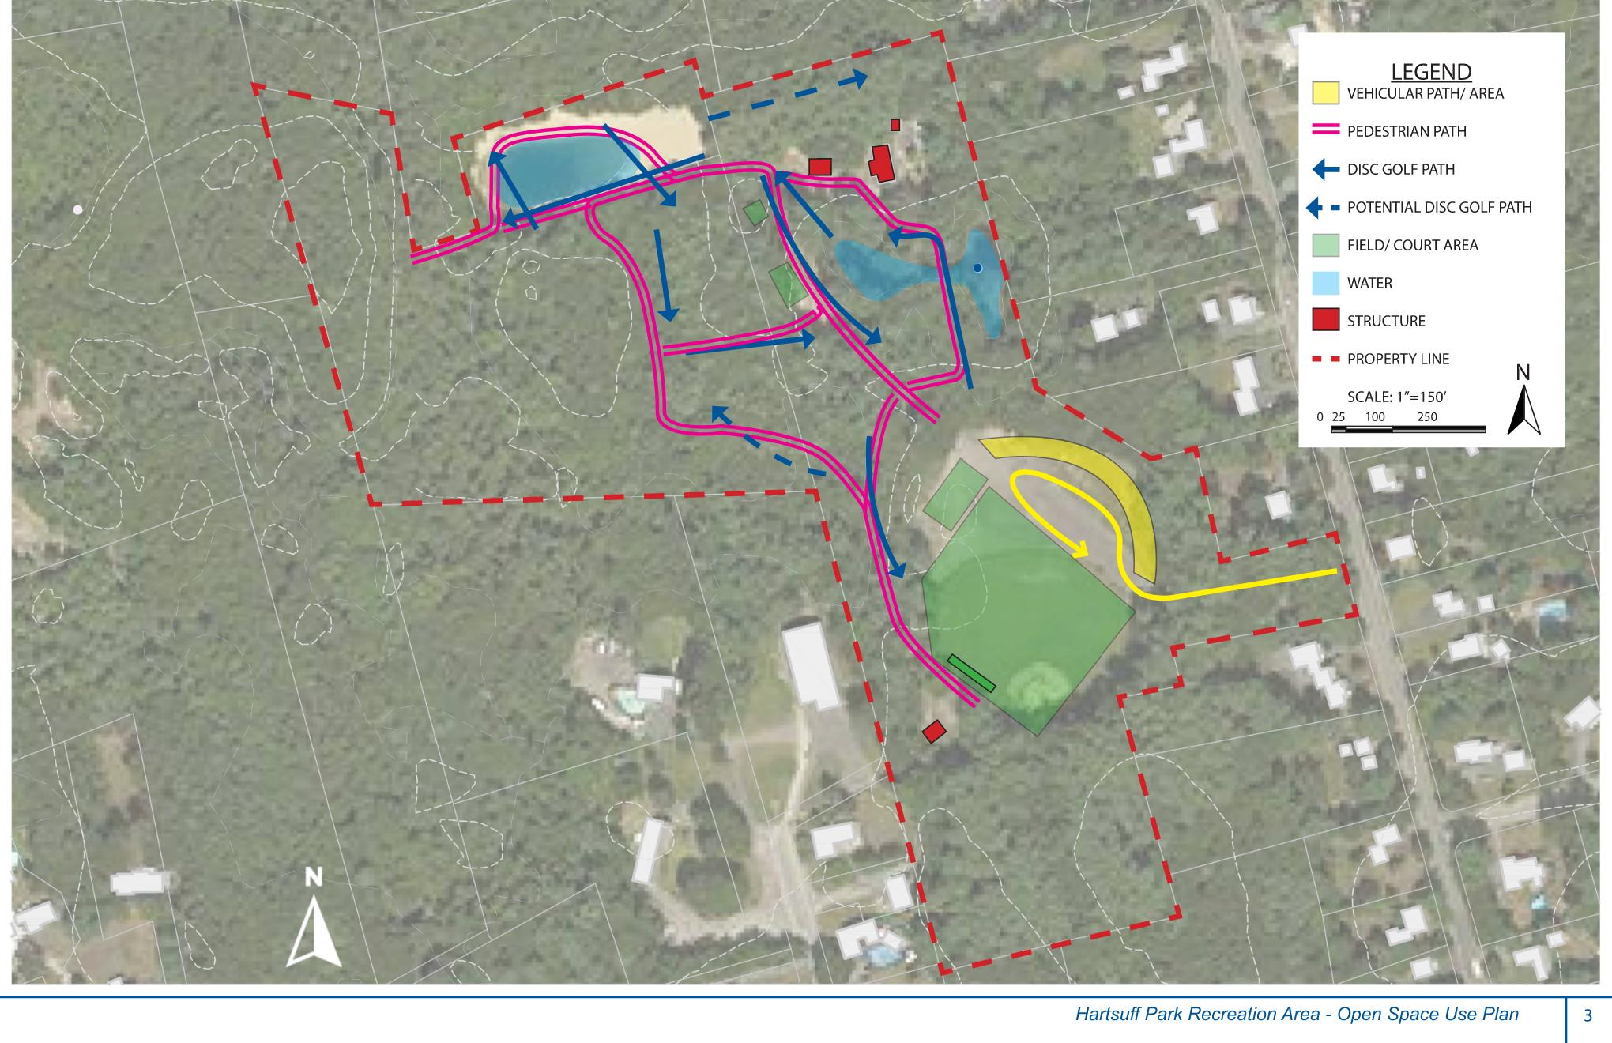

Slide 5
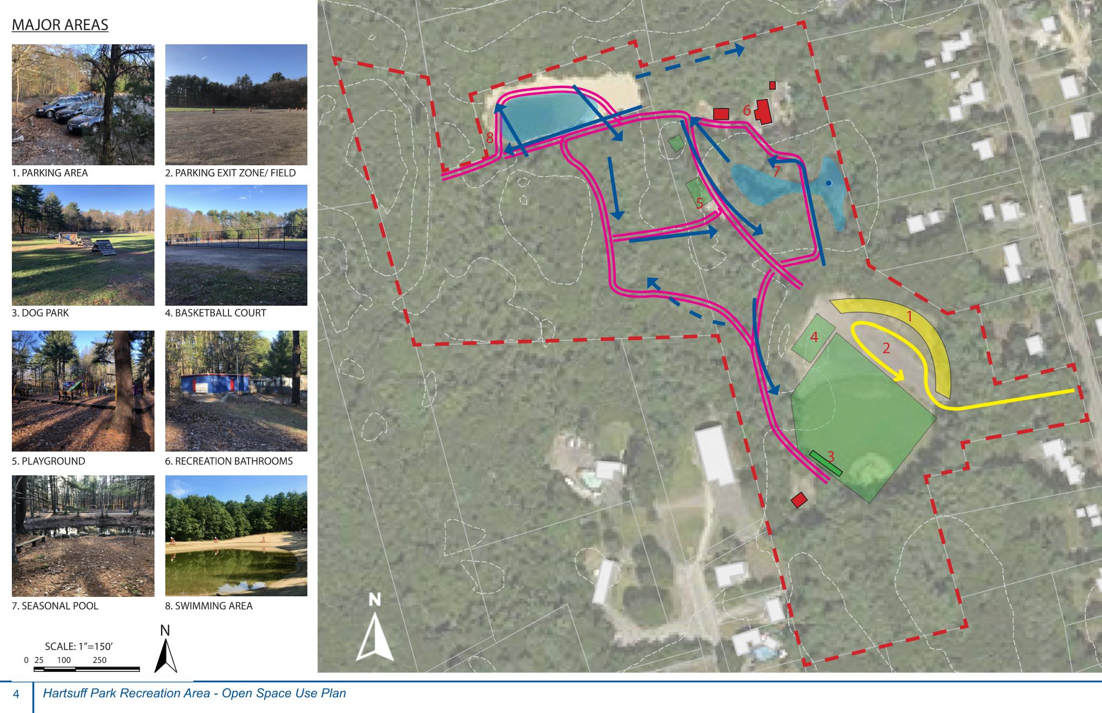

Slide 6
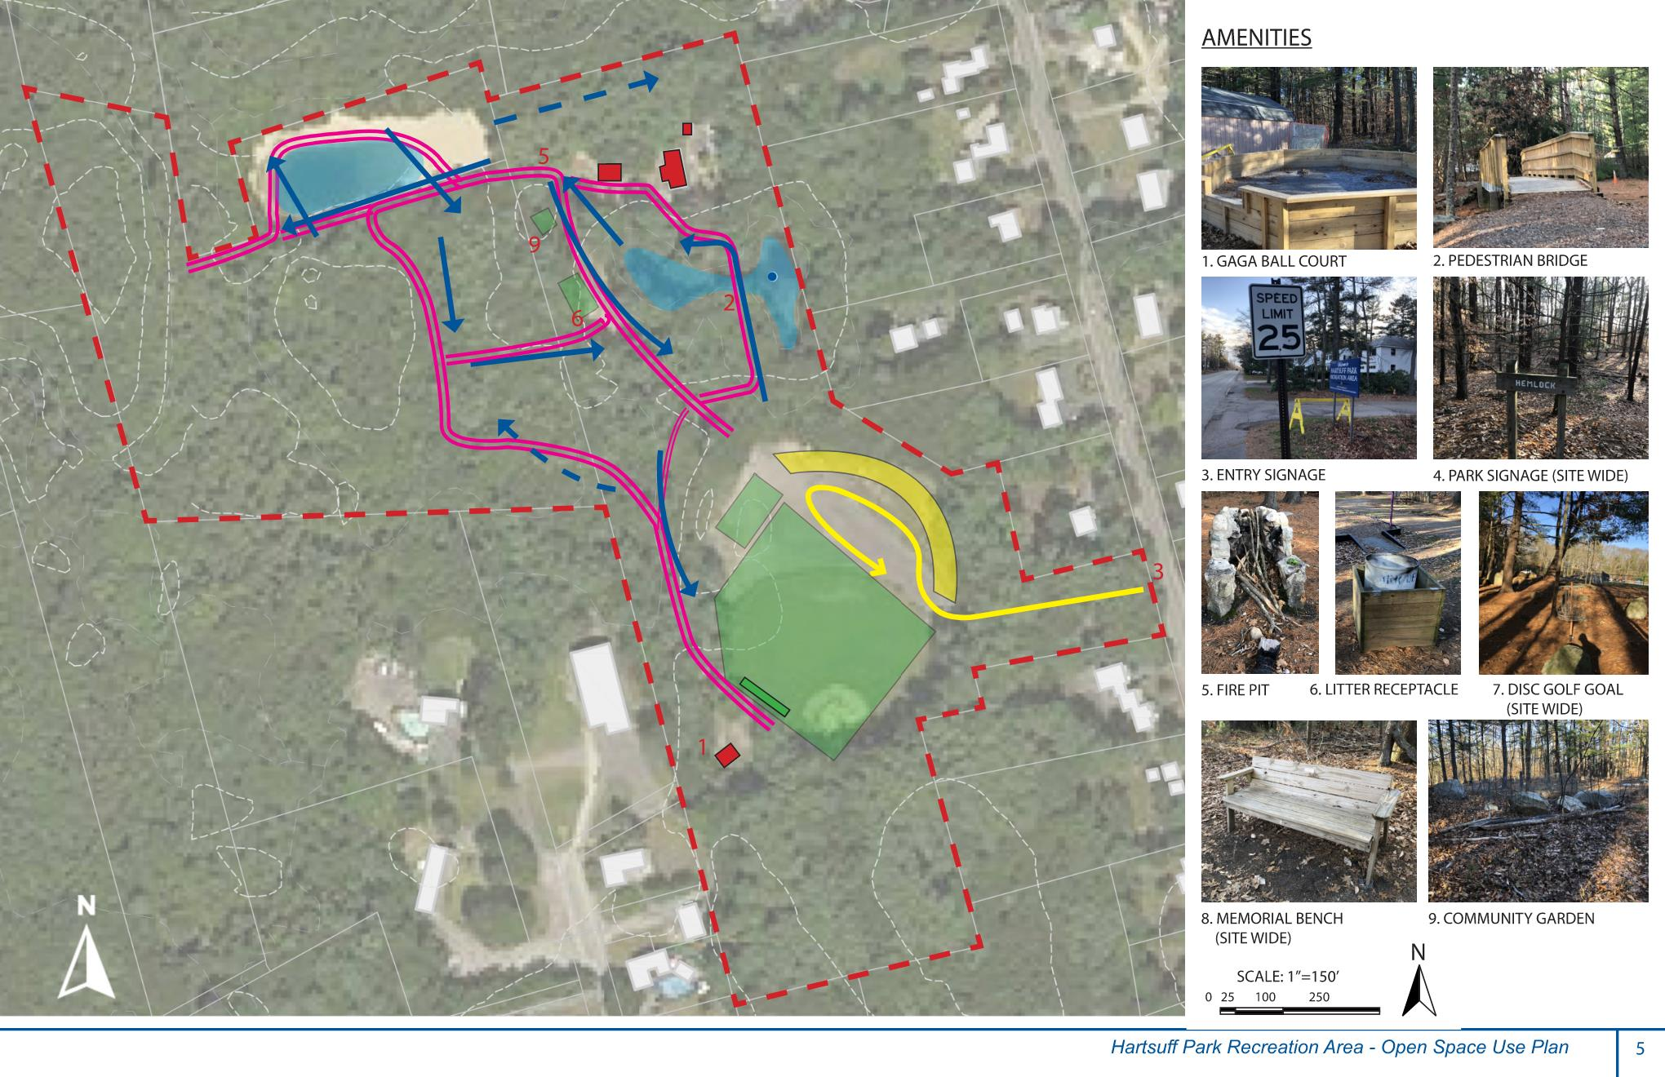

Slide 7
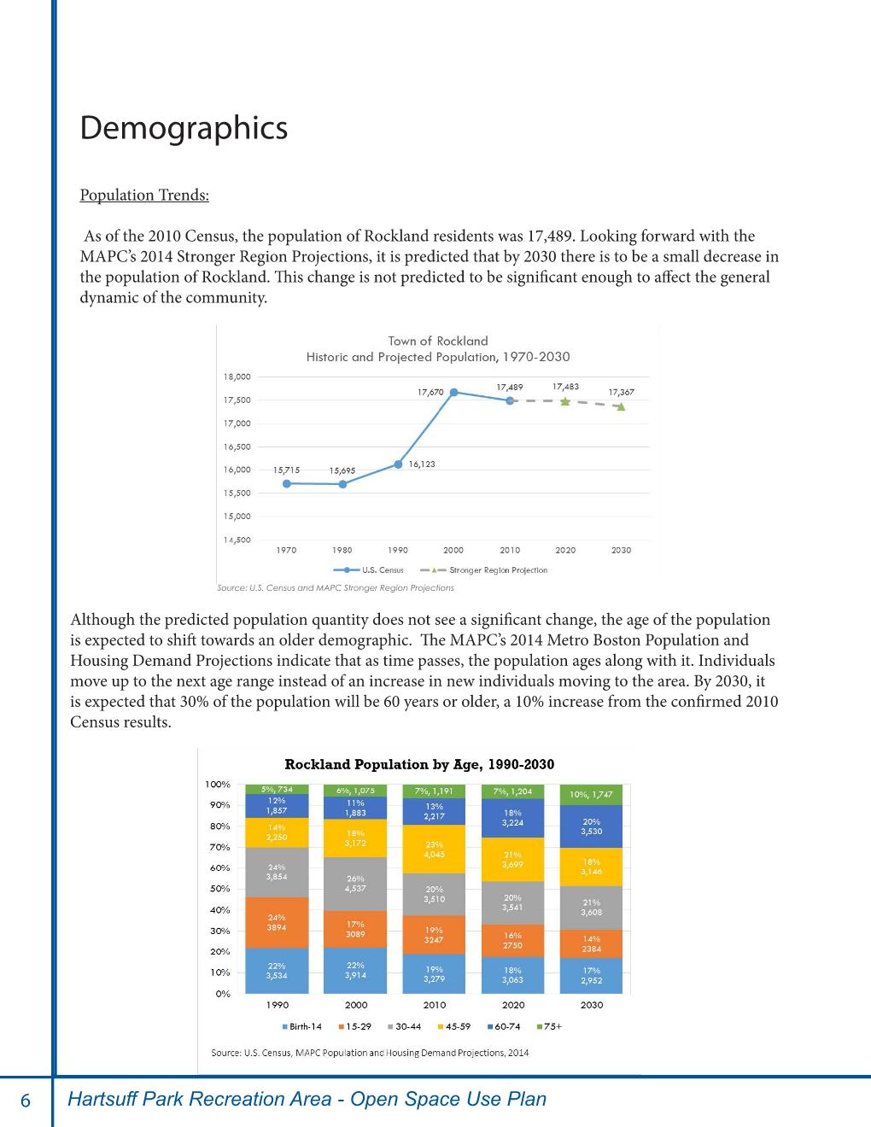

Slide 8
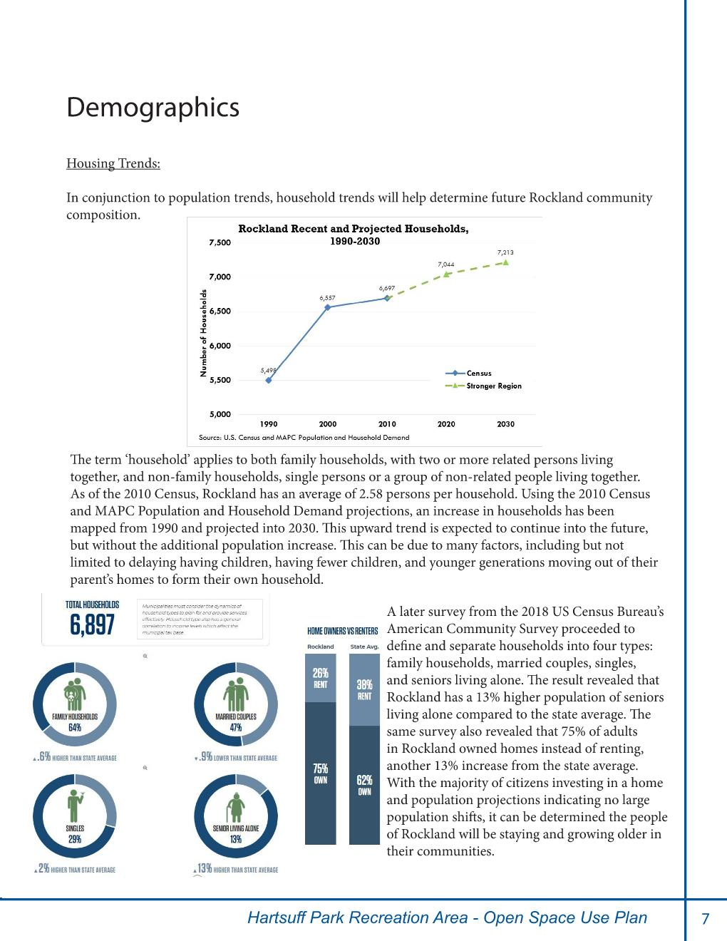

Slide 9
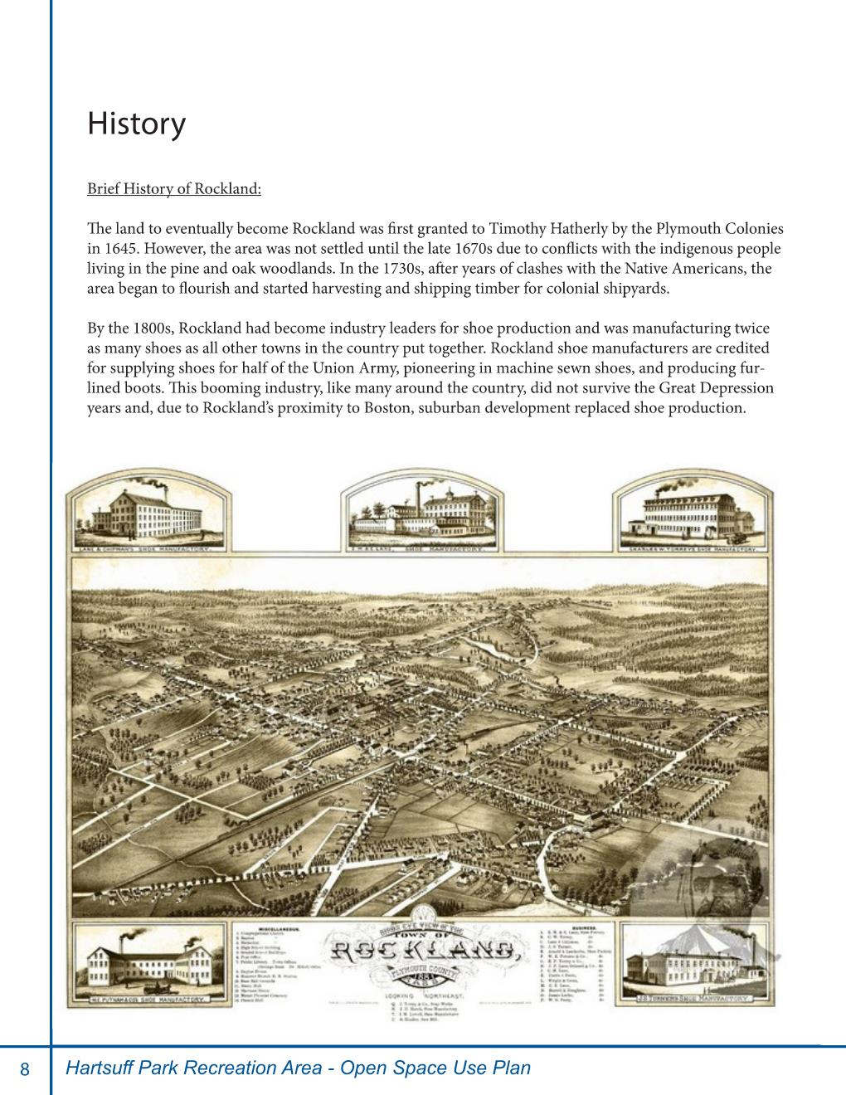

Slide 10
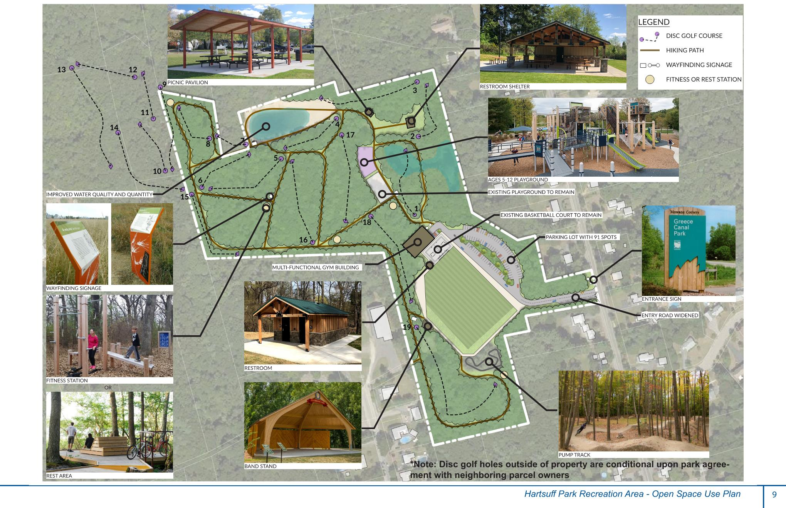

Slide 11
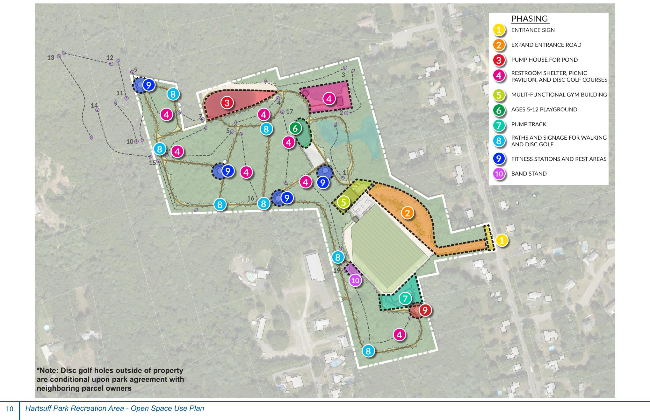

Slide 12
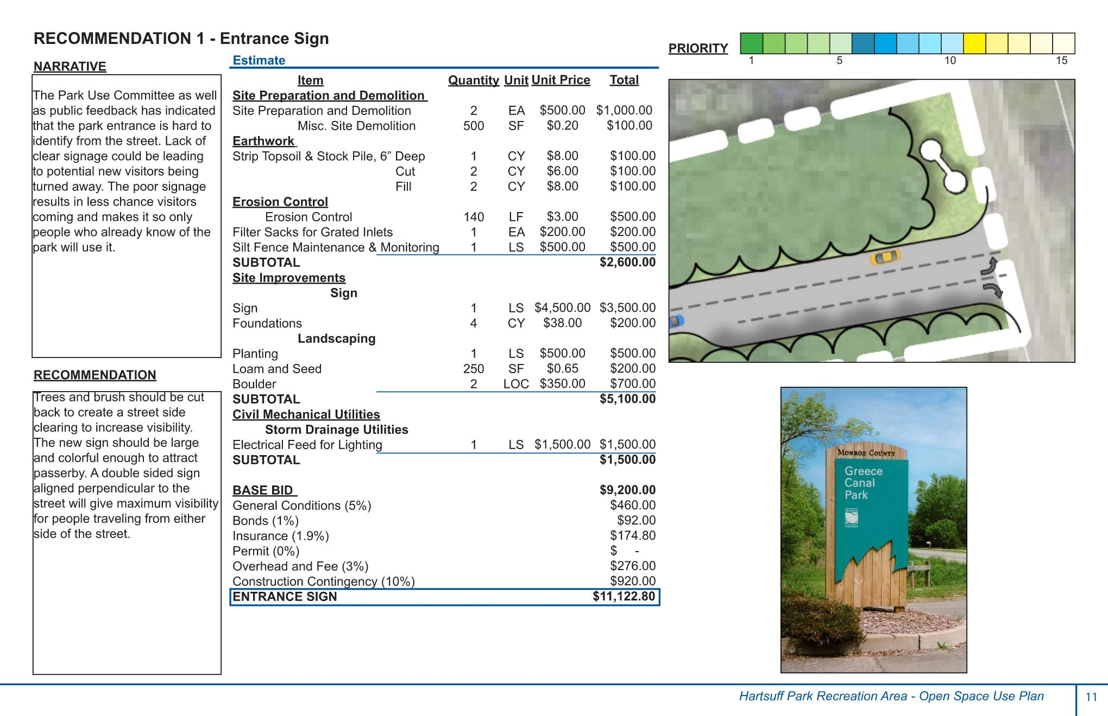

Slide 13
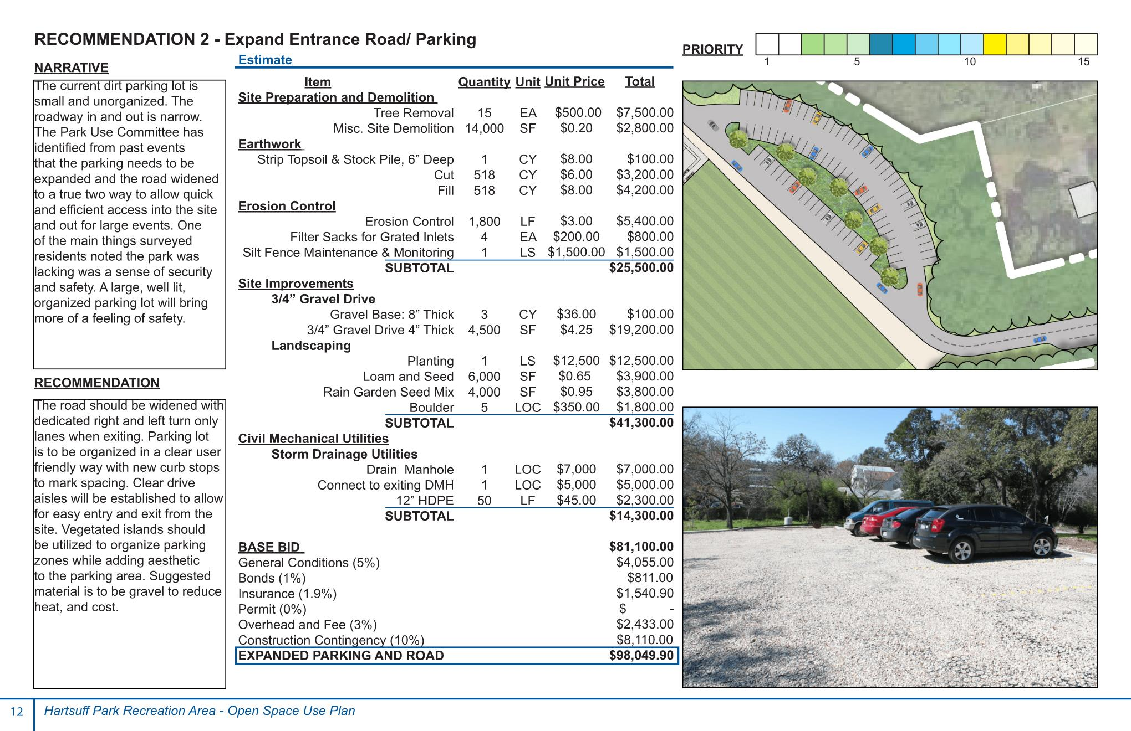

Slide 14
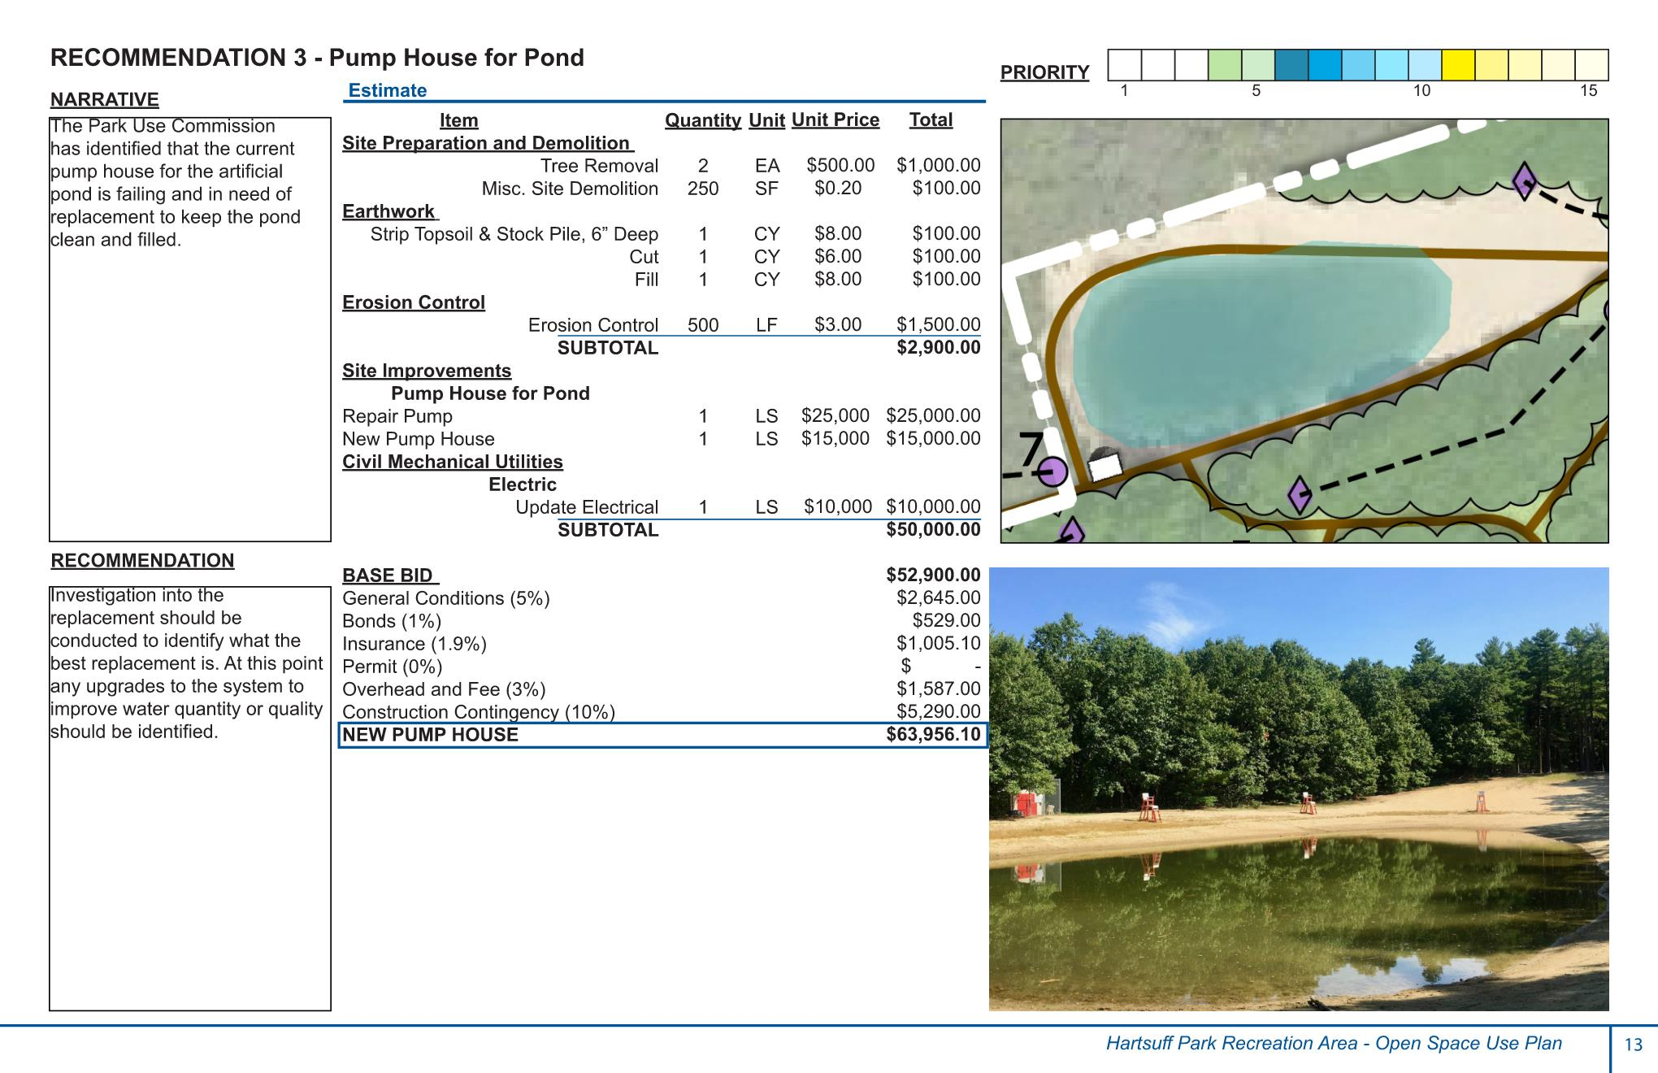

Slide 15
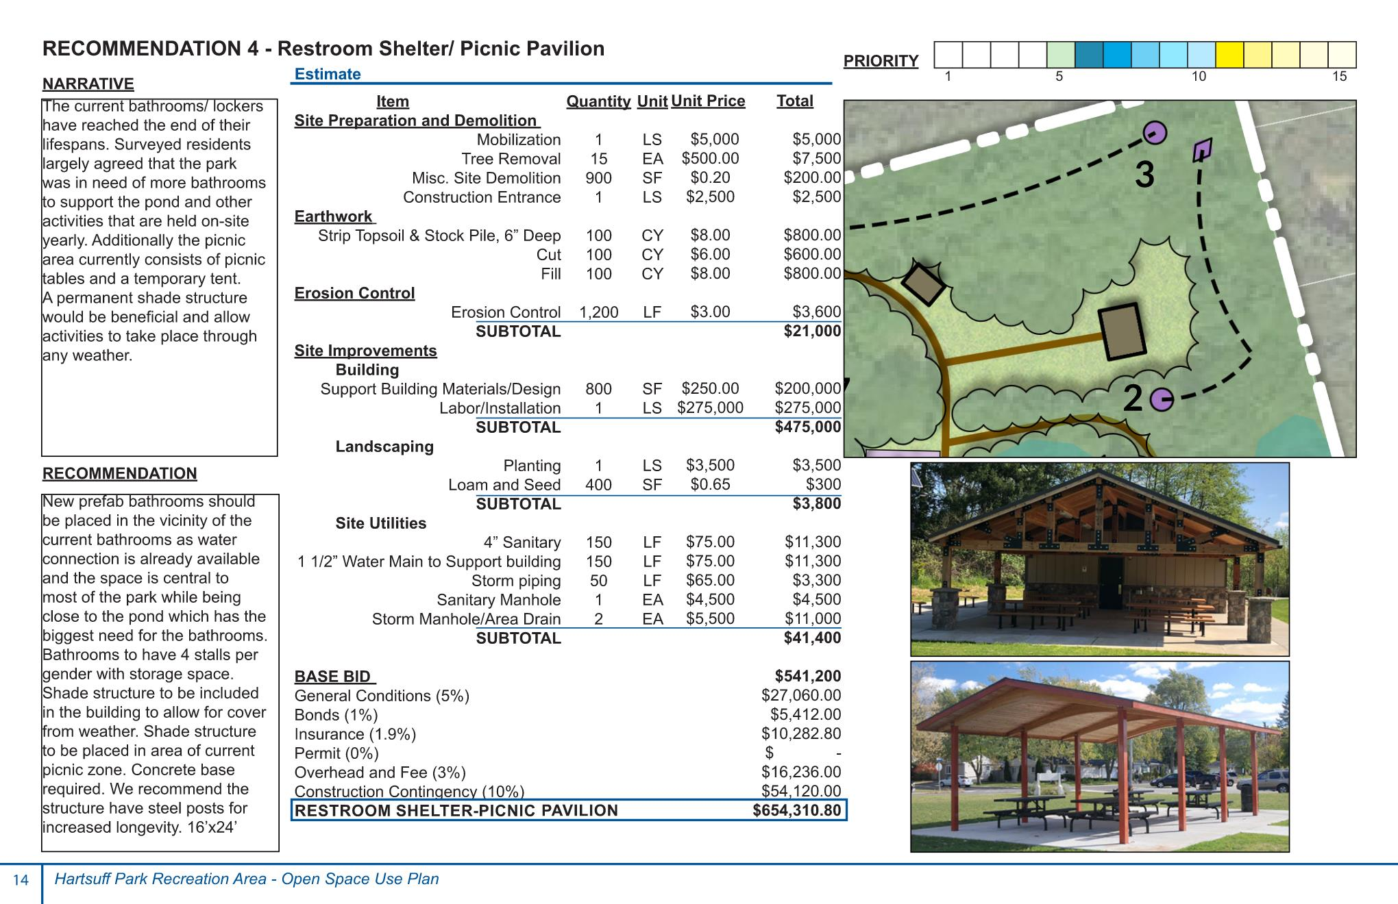

Slide 16
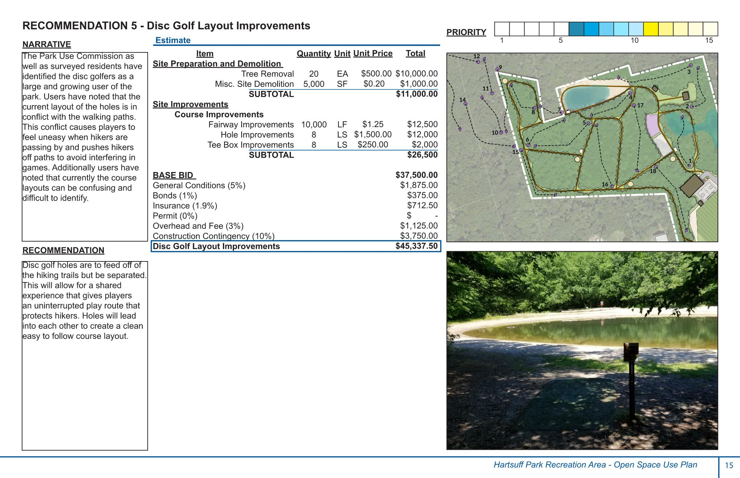

Slide 17
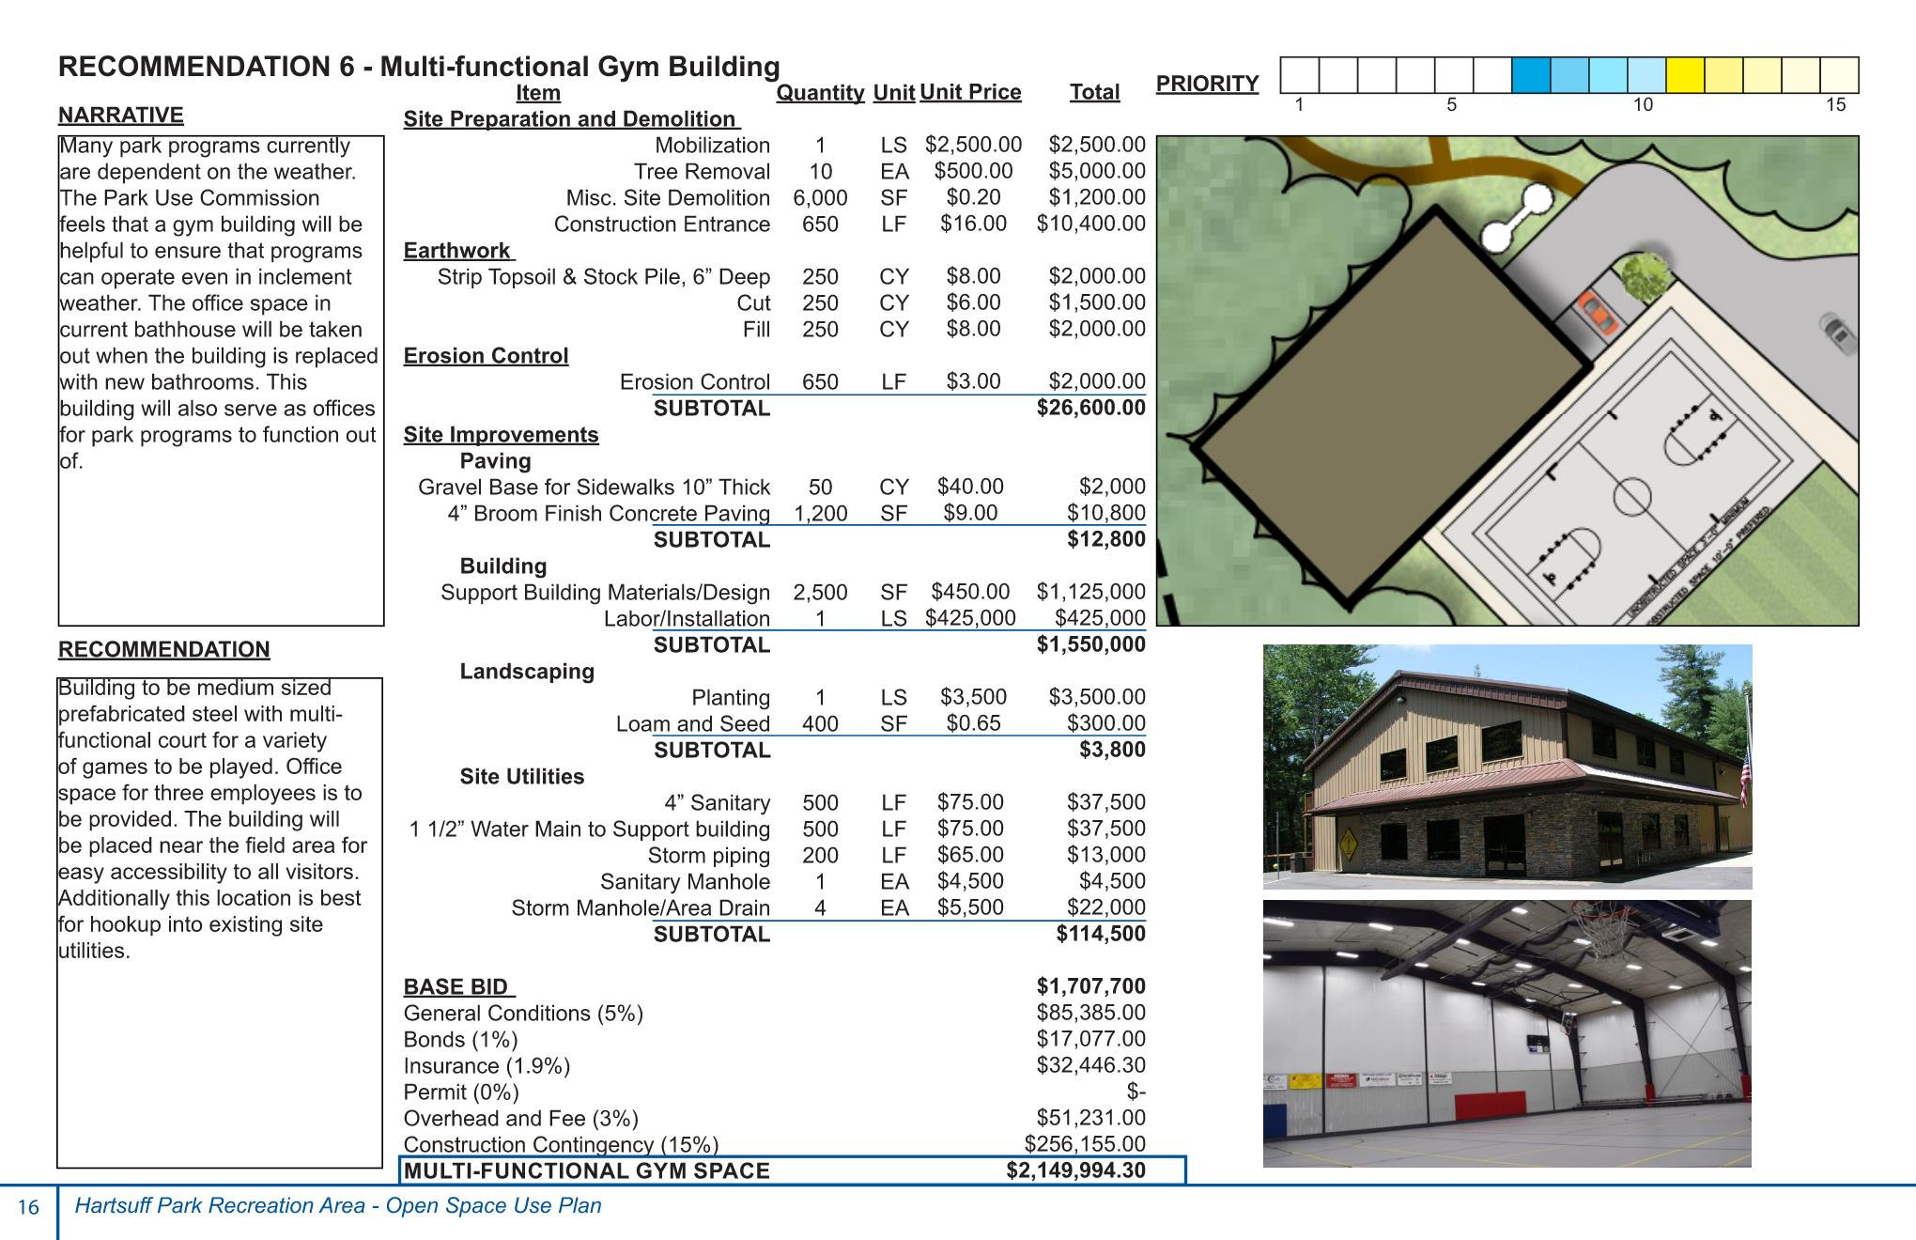

Slide 18
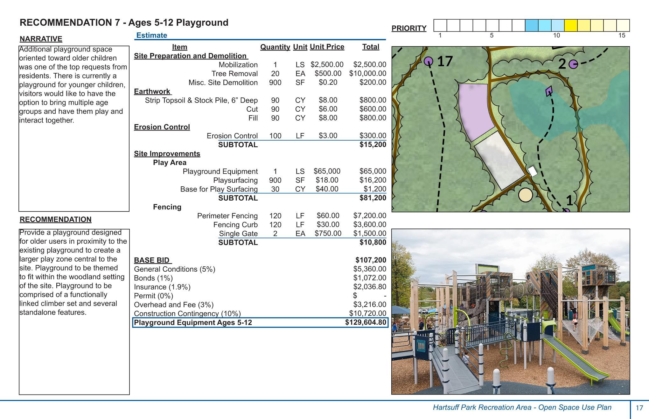

Slide 19
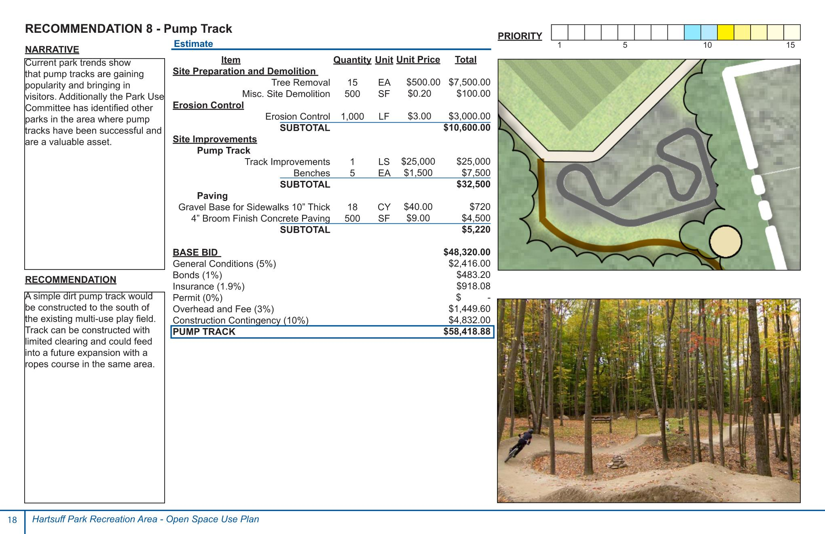

Slide 21
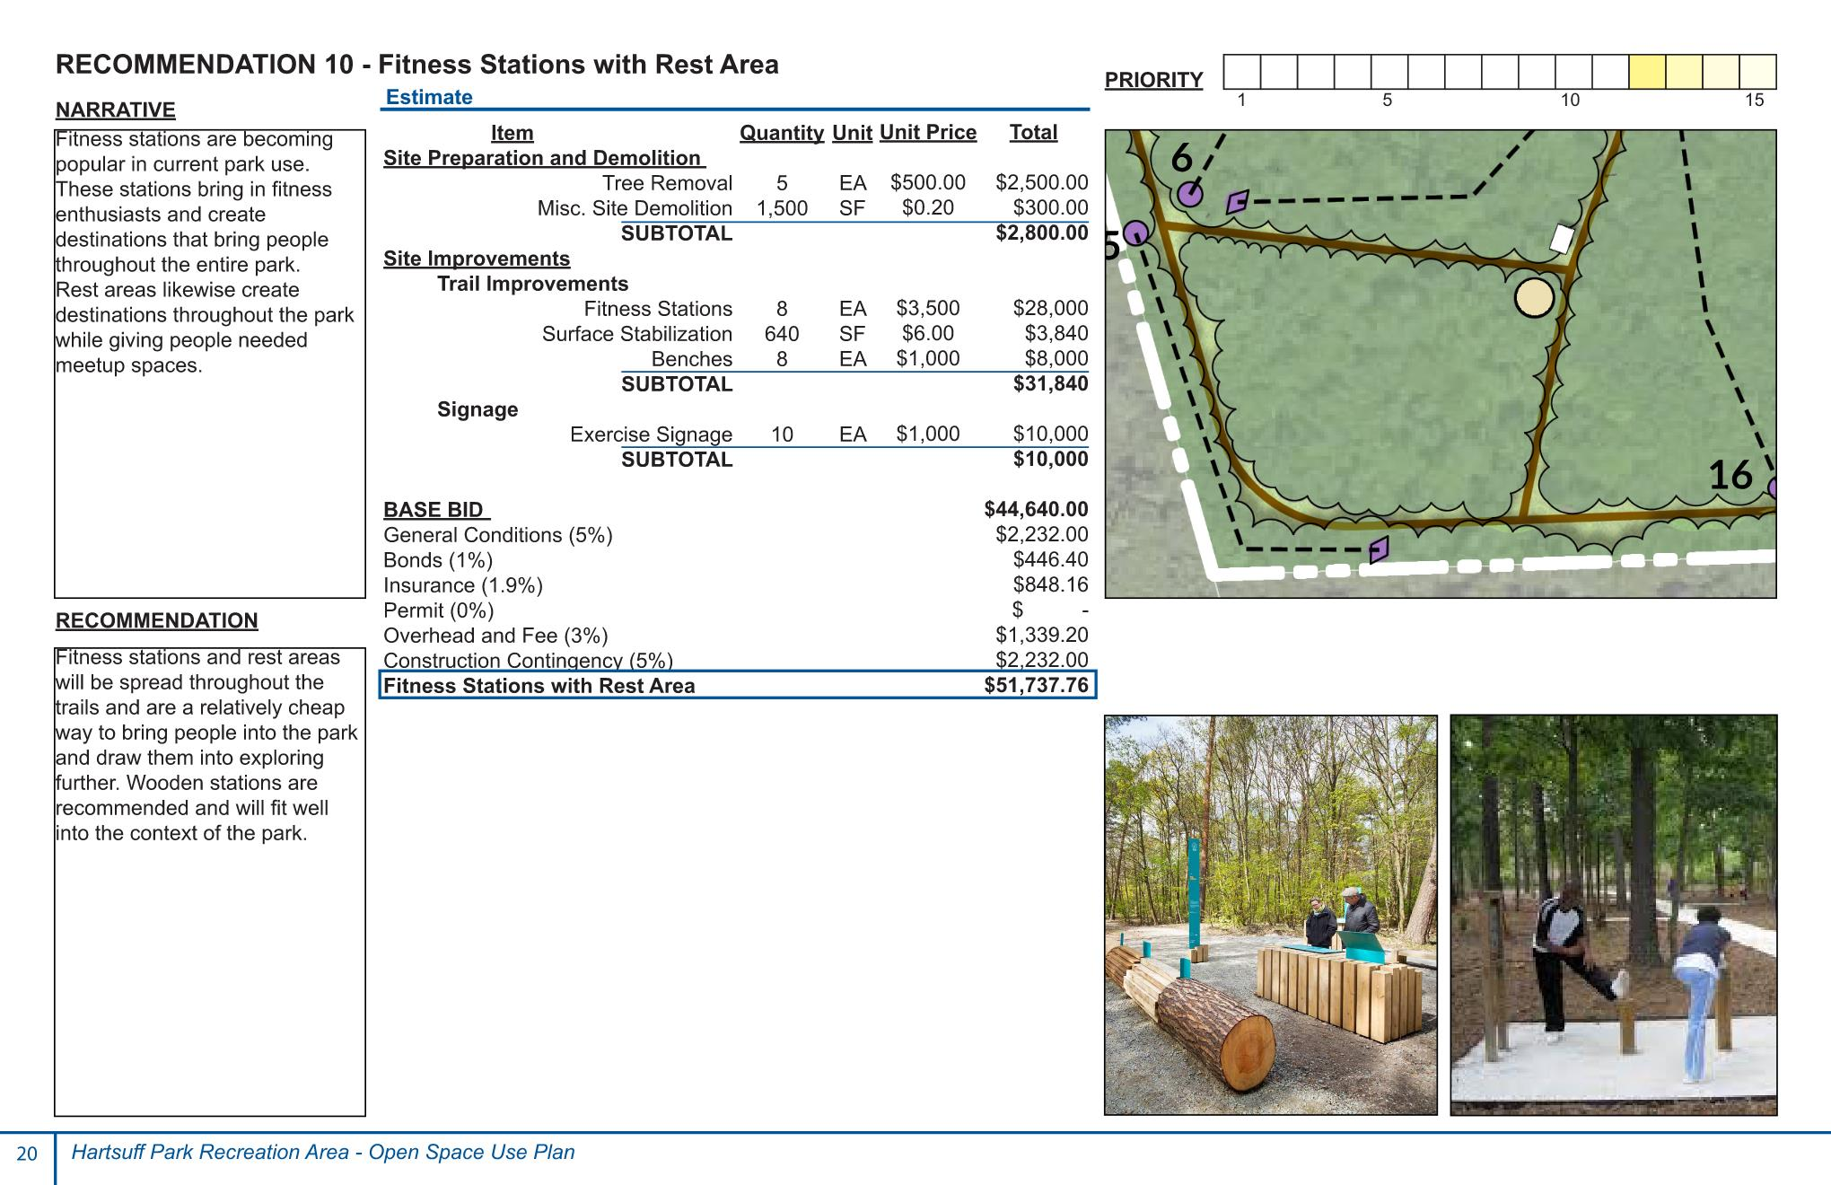

Slide 22
